Slide 1

Bitcoin vs Gold
2020–2025 Monthly Correlation Analysis
Noveno Andrew Martin
Testing the “digital gold” hypothesis via monthly log returns.

Slide 2

Research Questions & Objectives
Main Question: Is there a stable linear relationship between monthly gold and Bitcoin returns? Specific Objectives:
Measure full‑period correlation with 95% confidence interval (CI) Examine time‑varying correlation via 6‑ and 12‑month rolling windows Compare correlations across sub‑periods (2020–2021, 2022–2023, 2024–2025) Assess robustness using Spearman, bootstrap CI, winsorization & jackknife

Slide 3

Data Sources & Processing
Dataset | Provider | Frequency | Licence
Gold prices | DataHub | Monthly | PDDL
Bitcoin OHLCV | M. Jaouhari | Hourly → Monthly | MIT
Load raw CSV
Parse dates
Convert to EOM
Filter 2020–2025
Resample BTC hourly
Merge & compute returns
Processed dataset:
66 monthly observations (Feb 2020 – Jul 2025) stored in data/processed/.
Intermediate files reside in data/interim/.

Slide 4

Libraries & Tools Used
Python 3.13.8 with Jupyter Notebooks for a reproducible workflow.
pandas & NumPy for data wrangling, resampling BTC hourly data to month-end closes, and computing log returns.
SciPy (scipy.stats) for Pearson & Spearman correlation, p-values, and Fisher r-to-z confidence intervals.
Custom bootstrap and robustness checks (winsorisation, jackknife) implemented in Python.
Matplotlib for time-series plots, scatterplots, and rolling 6M/12M correlation charts.
Git & GitHub to version raw/interim/processed data and keep the analysis pipeline transparent.

Slide 5

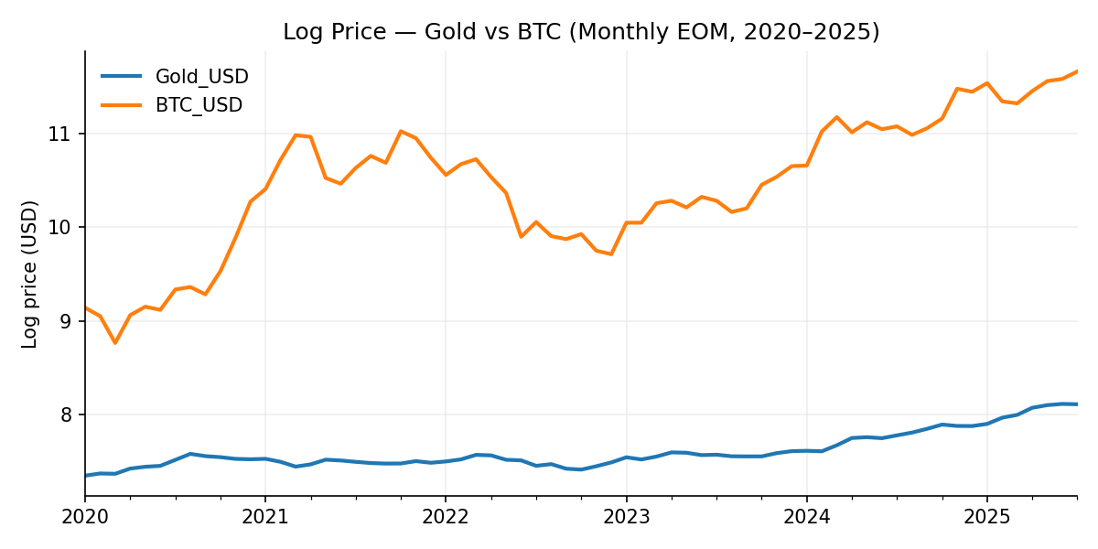
Visual Exploration: Price Dynamics
Observation: Bitcoin prices exhibit extreme volatility with explosive growth and crashes, while gold trends steadily upward. The scale differences motivate using log‑returns for analysis.

Slide 6

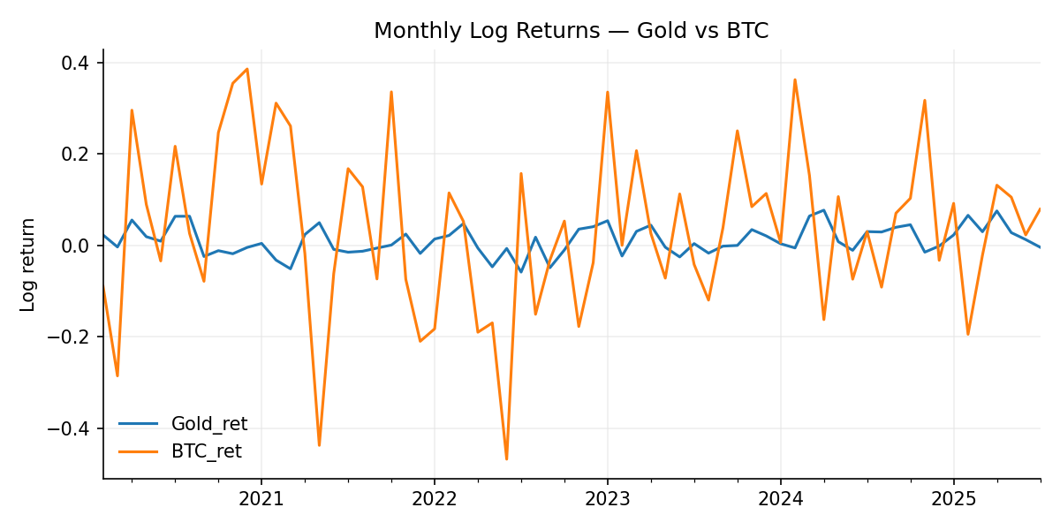
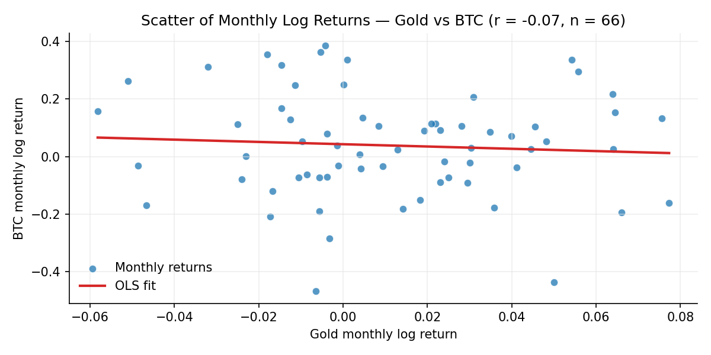
Visual Exploration: Monthly Returns
Overlay plot shows extreme monthly swings in Bitcoin and muted movements in gold. Scatter plot (r ≈ –0.07, CI crosses 0) indicates weak linear relationship over the full period.

Slide 7

Full‑Period Correlation
Statistic | Value
Sample size (n) | 66
Pearson r | -0.0686
p‑value | 0.5841
95% CI | [−0.3056, 0.1764]
Interpretation: The correlation between monthly log returns of Bitcoin and gold over the full 2020–2025 sample is weak (r ≈ –0.07) and statistically insignificant (p > 0.5). The wide confidence interval encompasses zero, suggesting no stable linear relationship.

Slide 8
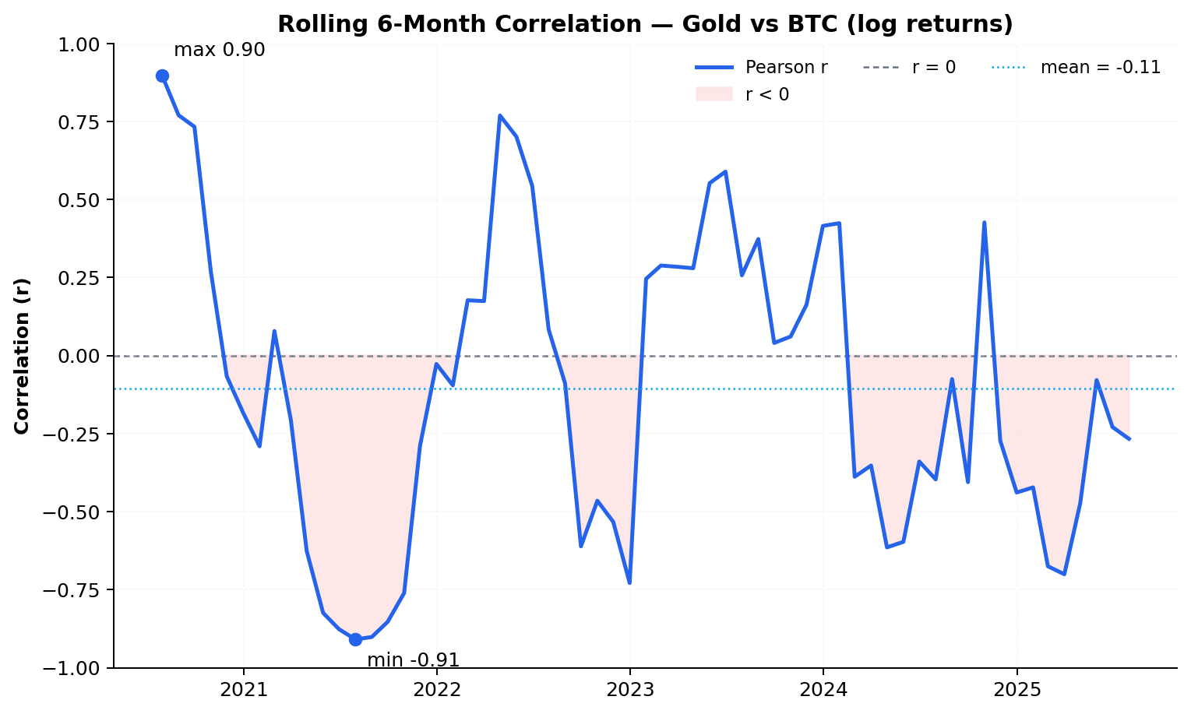
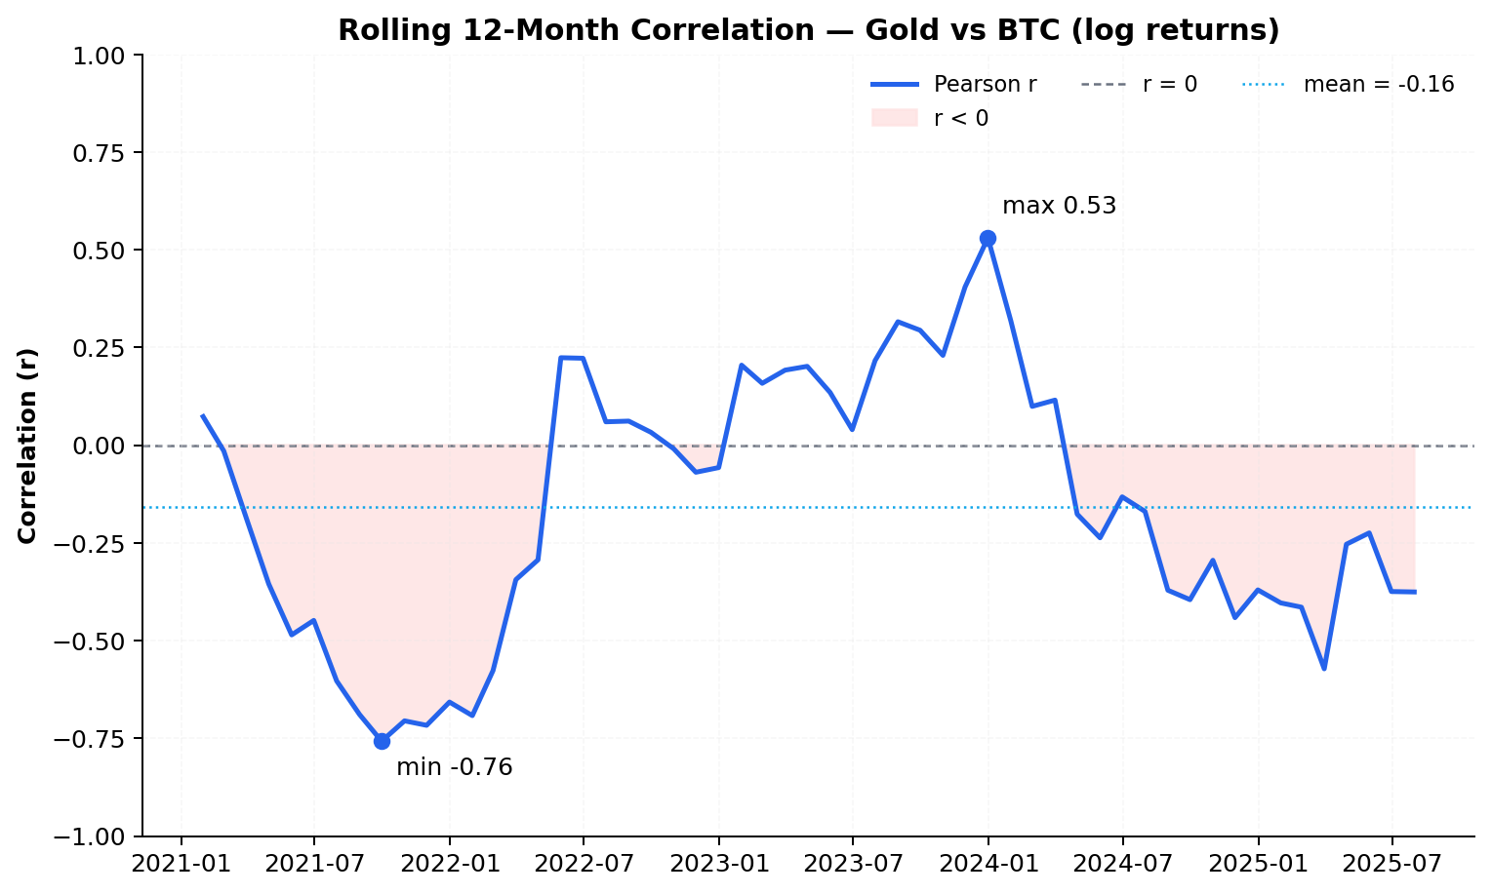
Rolling Correlation Analysis
Window | Mean | Min | Max | % negative
6‑Month | -0.1063 | −0.9095 | 0.8965 | 59%
12‑Month | -0.1591 | −0.7576 | 0.5301 | 62%
Patterns: Most rolling windows yield negative correlations; negative regimes occur during late 2021/early 2022 and again in 2024–2025, whereas mid‑2023 displays positive correlation.

Slide 9
Sub‑Period Correlations
Period | n | Pearson r | p‑value
2020–2021 | 24 | -0.2177 | ≈ 0.32
2022–2023 | 24 | 0.2116 | ≈ 0.32
2024–2025 | 18 | -0.3618 | ≈ 0.13
Observation: The sign of the correlation flips across sub‑periods: negative during 2020–2021, positive in 2022–2023, and negative again in 2024–2025. None of the sub‑periods reach conventional significance (p ≥ 0.05).

Slide 10

Robustness Checks
Method | Statistic
Pearson r | -0.0686
Fisher 95% CI (lo, hi) | [−0.3056, 0.1764]
Bootstrap 95% CI (lo, hi) | [−0.3108, 0.1955]
Spearman ρ | −0.0525 (p = 0.675)
Winsor & Jackknife | No single observation dominates
Takeaways: Alternative measures (bootstrap, Spearman) corroborate the weak relationship. Winsorisation and jackknife analyses confirm that extreme months do not drive the result.

Slide 11
What I Learned from This Project
Technical skills: pandas for resampling, rolling window; matplotlib for custom themes; scipy for basic statistics.
Workflow: the importance of the raw → interim → processed → reports folder structure, and utilize GitHub.
Insight: the expectation of "Bitcoin = digital gold" is not automatically supported by data; it's important to check long-term data, not just specific periods in the media.
Time management

Slide 12

Future Work & Reflection
Explore higher‑frequency data (daily/weekly) and additional assets (e.g. S&P 500, bonds) to contextualise correlations. Investigate non‑linear dependence using models like DCC‑GARCH or copulas. Reflect: building reproducible pipelines in Python emphasises the importance of clear data processing and visualising rolling statistics to reveal temporal dynamics.

Slide 13
Conclusions
No evidence supports a stable “digital gold” correlation between Bitcoin and gold. Correlations are regime‑dependent, switching from negative to positive across sub‑periods. Any safe‑haven role of Bitcoin is episodic rather than persistent. Limitations: sample size (~66 months), reliance on linear methods, and unmodelled macroeconomic factors (e.g. monetary policy, crises).

